Slide 1
NoSQL - Mongodb
Presented by:
Yasmin Ghazy

Slide 2
Agenda
SQL vs NoSQL
Json vs Bson
Document relationships
CRUD operation
Query operation
Aggregation
Validation
Transactions
Indexing

Slide 3
MongoDB vs SQLMS
Feature | MongoDB | RDBMS (SQL)
Data Model | Document-oriented | Table-based
Schema | Dynamic/Flexible | Fixed
Joins | No Joins | Supported
Scalability | Horizontal | Vertical
Stored in | collection | tables
rows | Each document is a record | records
Notes:
2* -Layer7 (HTTP) – Create new http request
-Layer4 (TCP) – Reroute -encryption, decryption in layer 6 - SSL

Slide 4
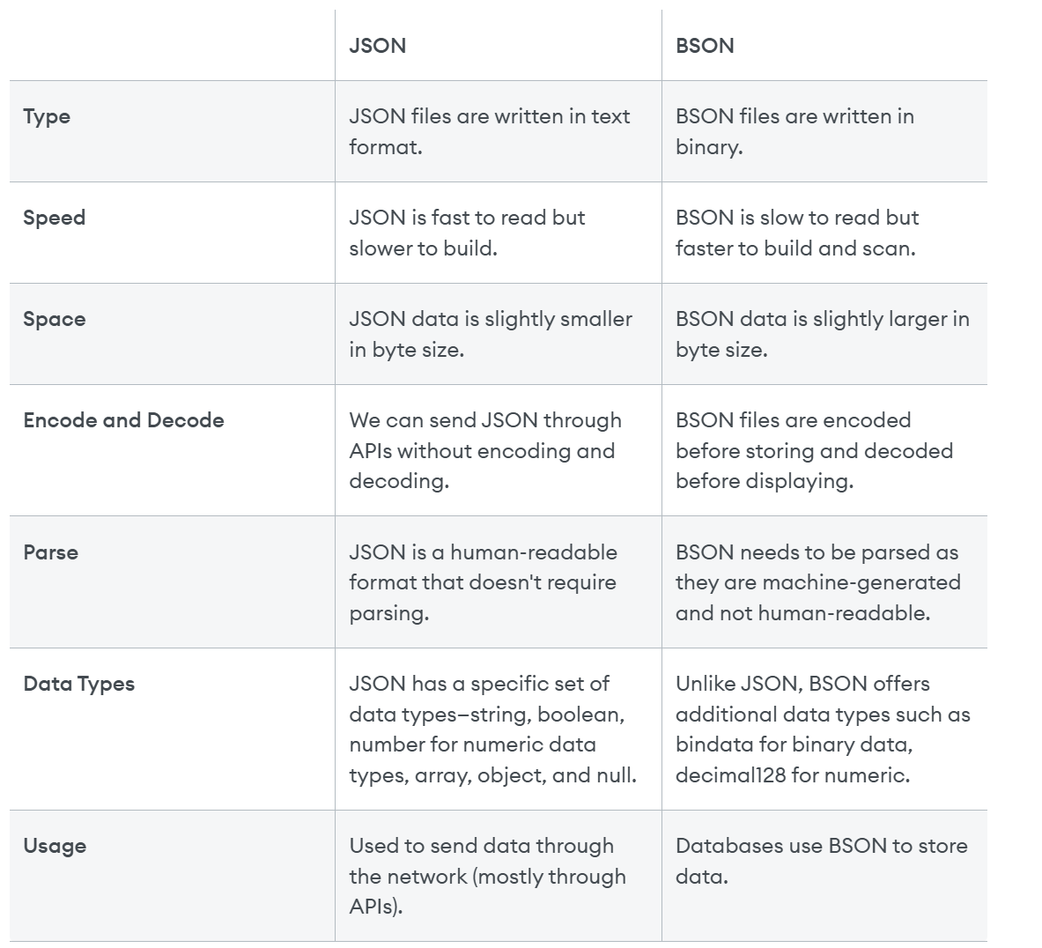
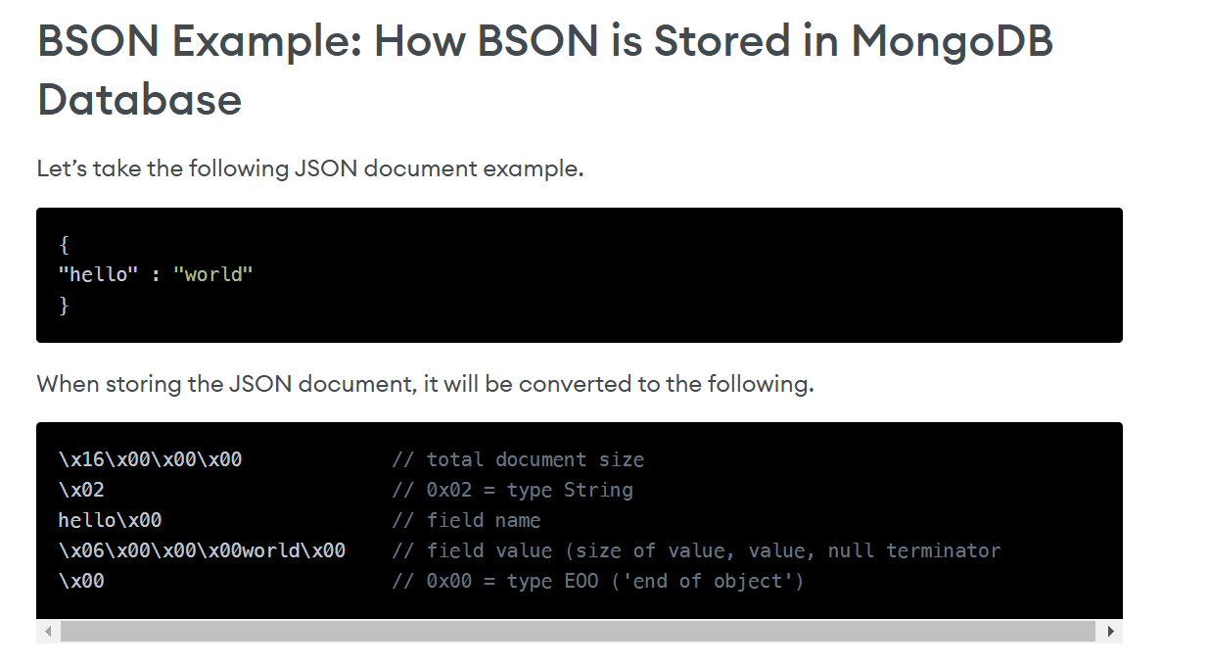
Json vs Bson
Notes:
2* -Layer7 (HTTP) – Create new http request
-Layer4 (TCP) – Reroute -encryption, decryption in layer 6 - SSL

Slide 5
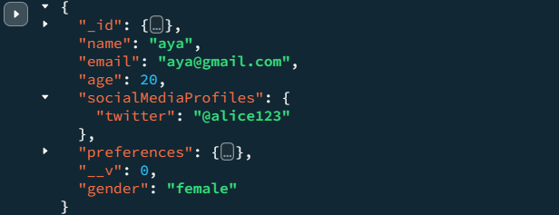
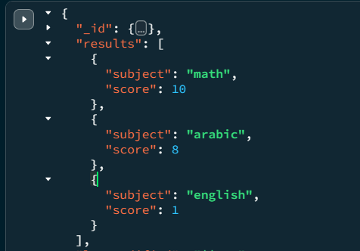
Document Embedded Relationships
Model One-to-One with Embedded Documents
(user , social media profiles)
Model One-to-Many with Embedded Documents (user , results)

Slide 6
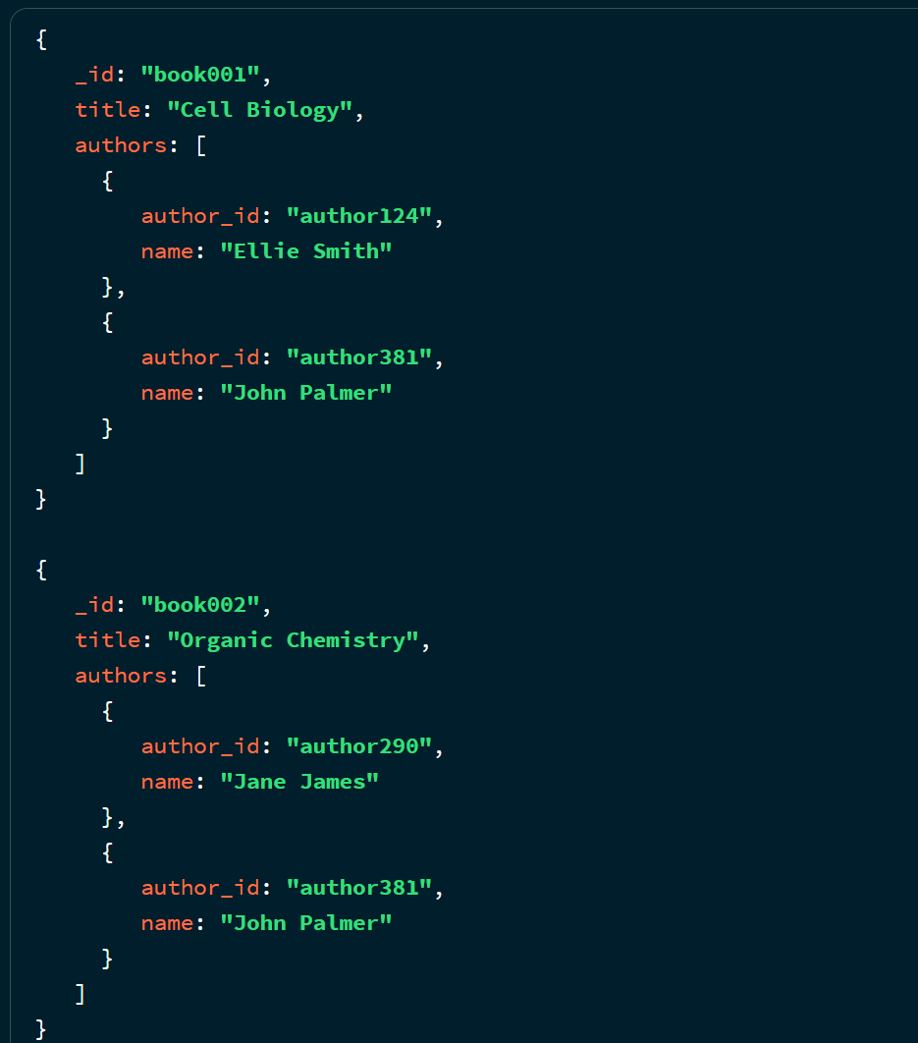
Document Embedded Relationships
Model Many-to-Many(book , auther)
Embedded Document Pattern
The application needs to display information for the book and author objects on a single page. To allow your application to retrieve all necessary information with a single query, embed author information inside of the corresponding book document:

Slide 7
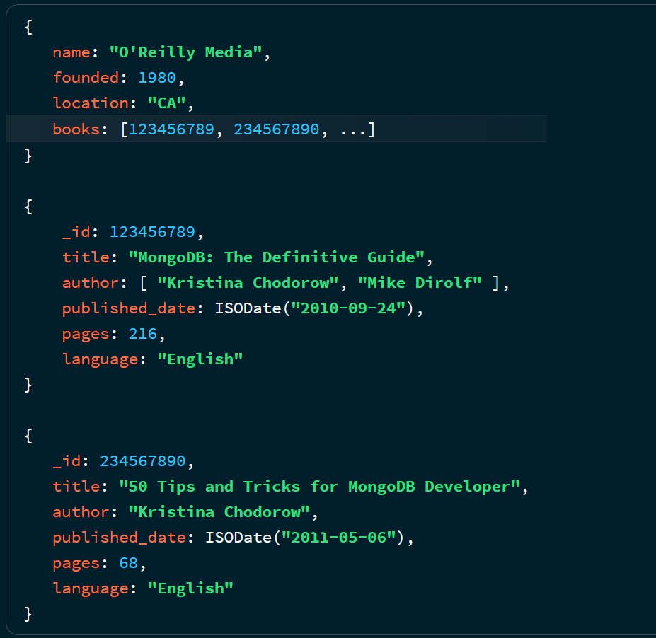
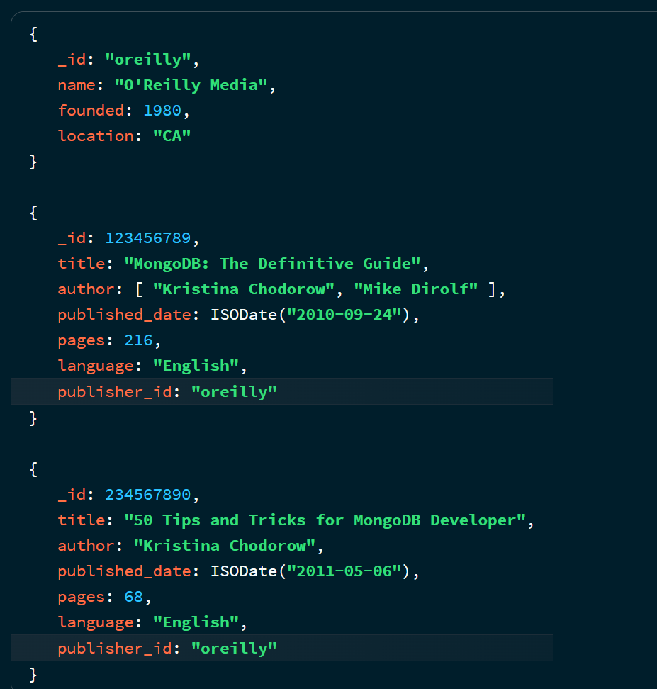
Document References Relationships
Model One-to-Many
(publisher , book)
To avoid growing arrays, store the publisher reference inside the book document:

Slide 8
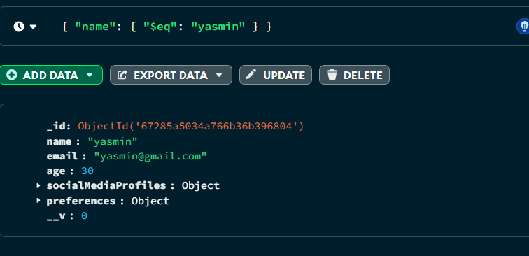
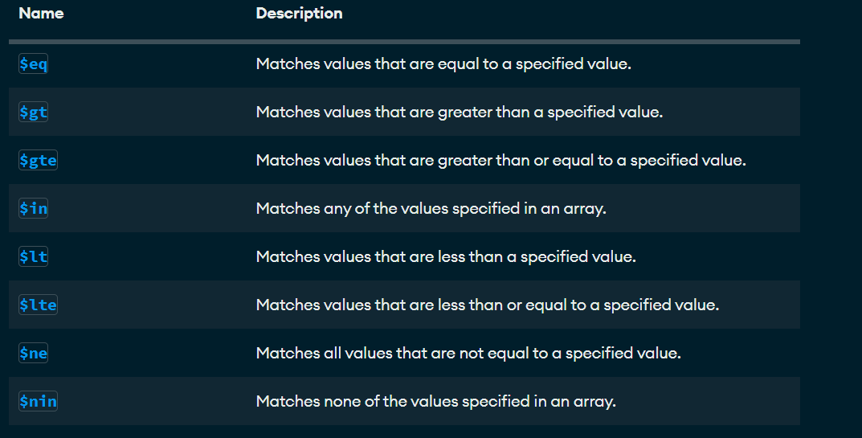
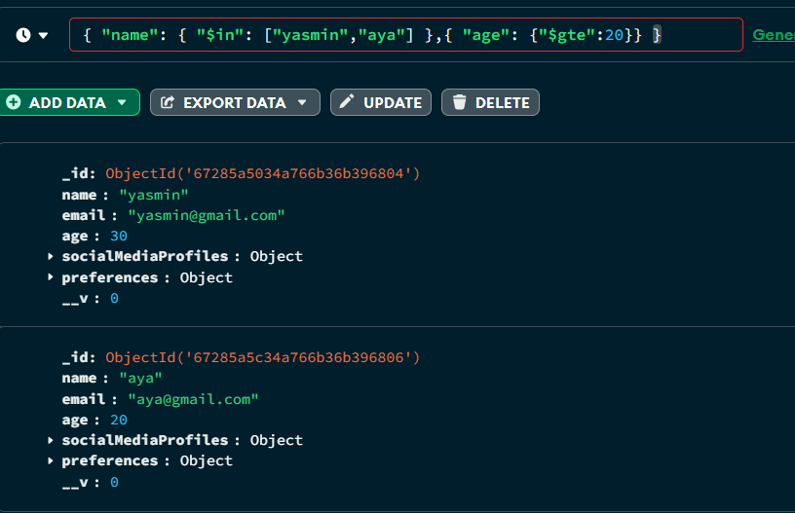
Query Operators - Comparison Operators

Slide 9
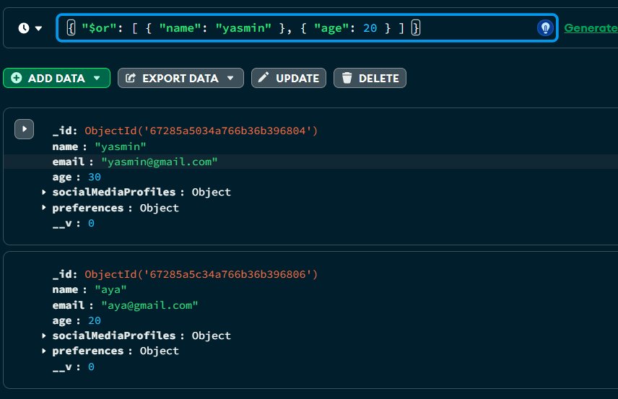
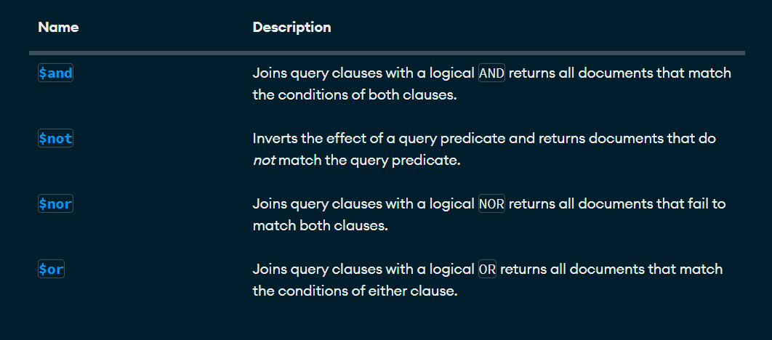
Query Operators - Logical Operators

Slide 10
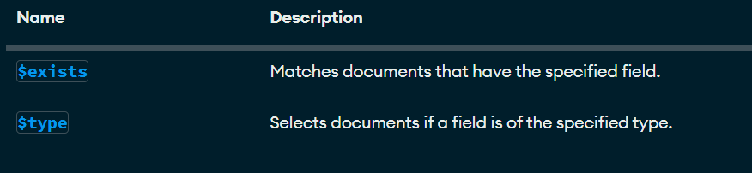
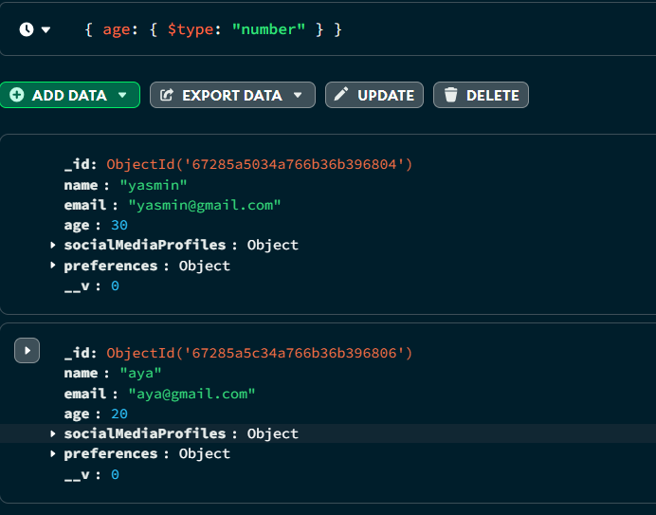
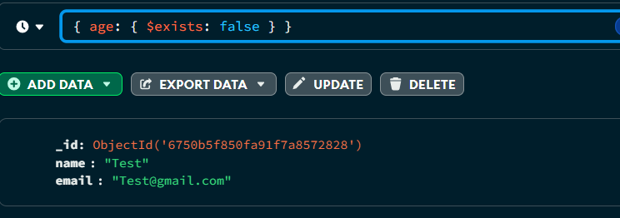
Query Operators - Element Query Operators
selects documents where the value of the field is an instance of the specified BSON type
matches documents that contain or do not contain a specified field

Slide 11
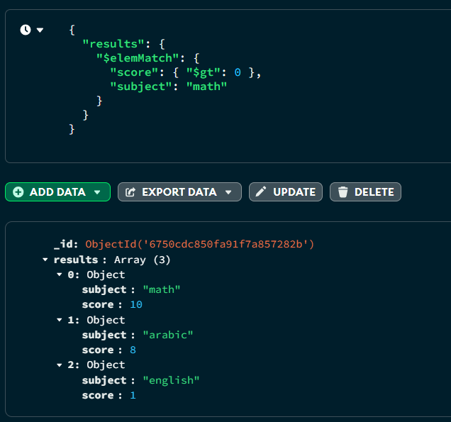
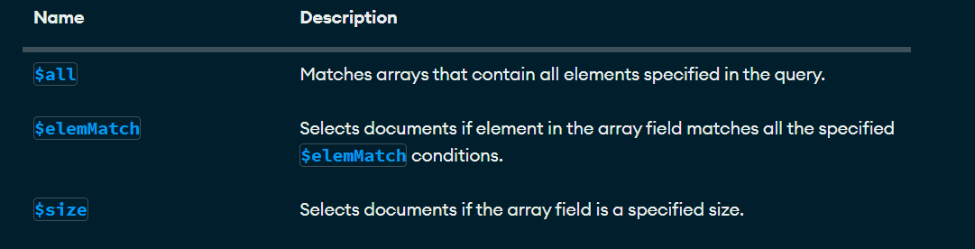
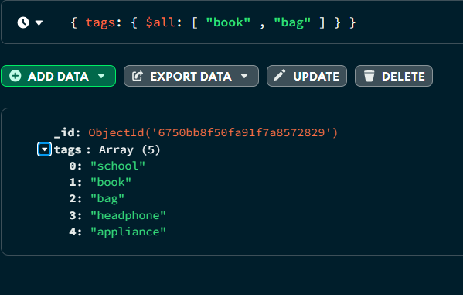
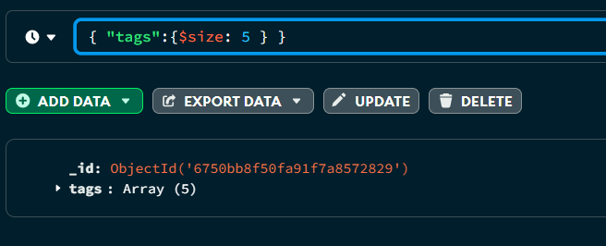
Query Operators - Array Query Operators
Equivalent to : { $and: [ { tags: "book" }, { tags: "bag" } ] }

Slide 12
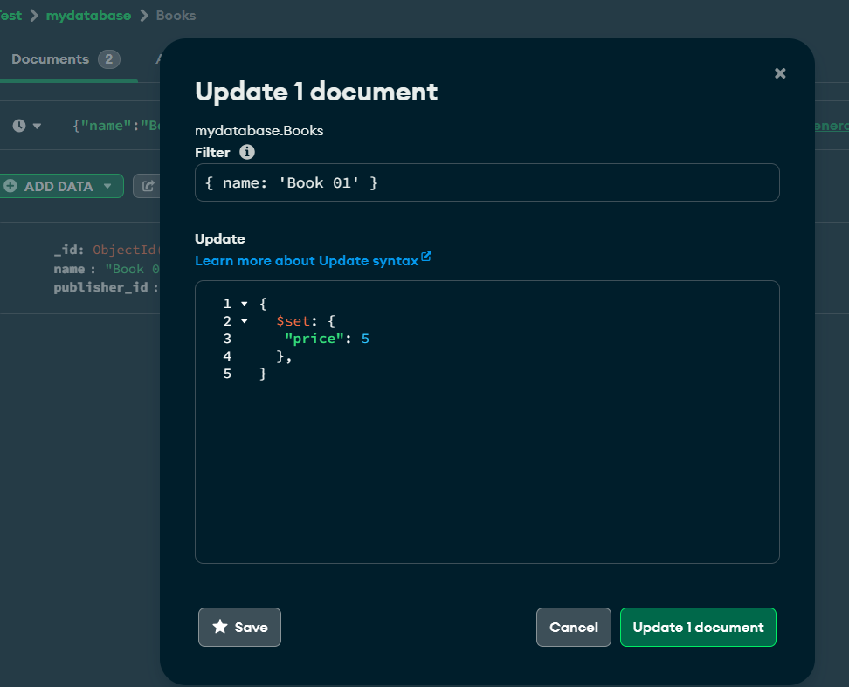
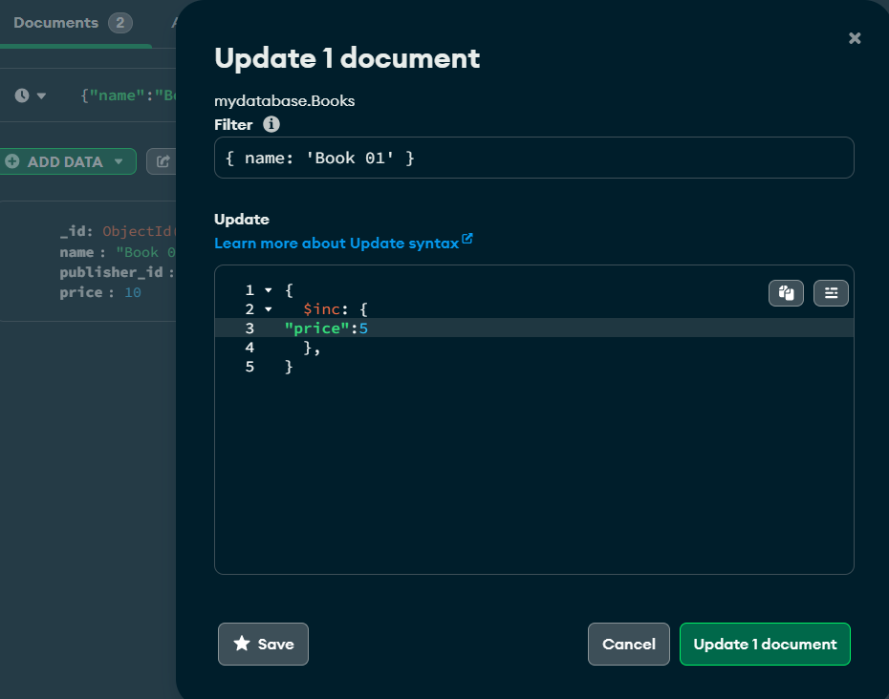
CRUD operation - update
$Set price to 5 if not exist add it
$inc increase price by 5

Slide 13
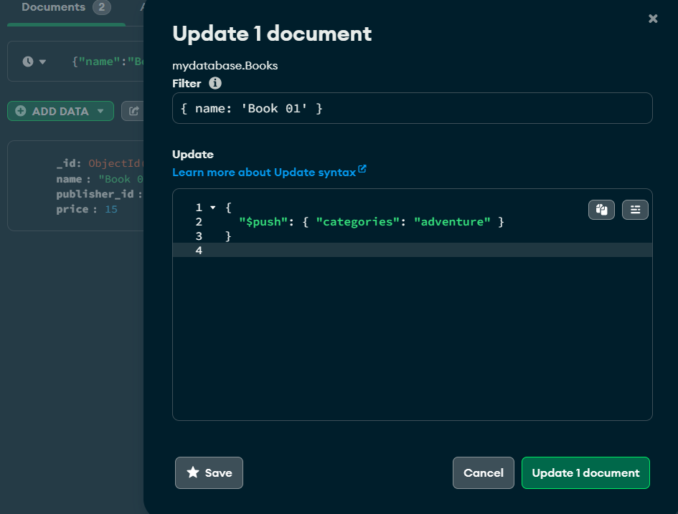
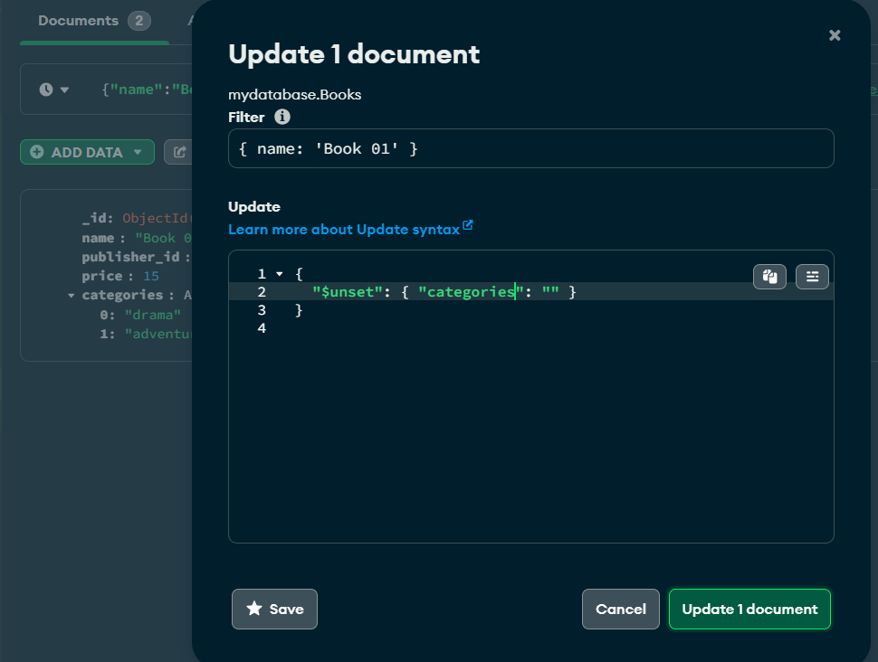
CRUD operation - update
$Push new category if categories exists if not add it
$unset remove categories field

Slide 14
CRUD operation - update
$Push new category if categories exists if not add it
$unset remove categories field

Slide 15
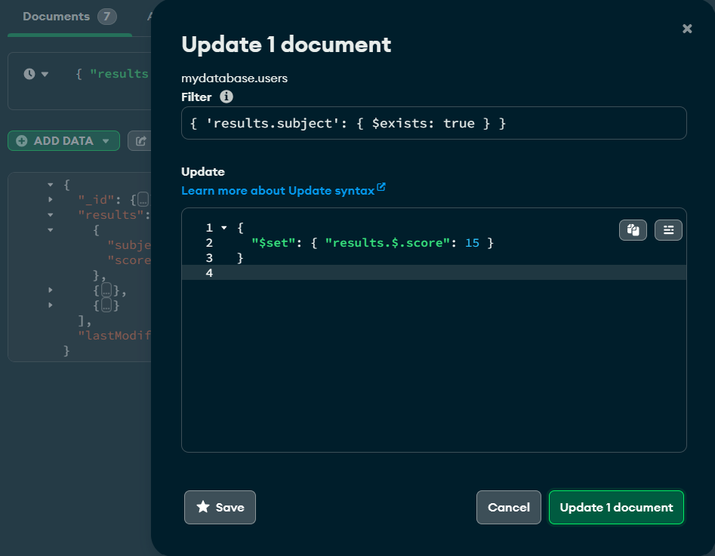
CRUD operation - update
$set modifies the score of the subject. The $ operator targets the first matching element inside the results array.

Slide 16
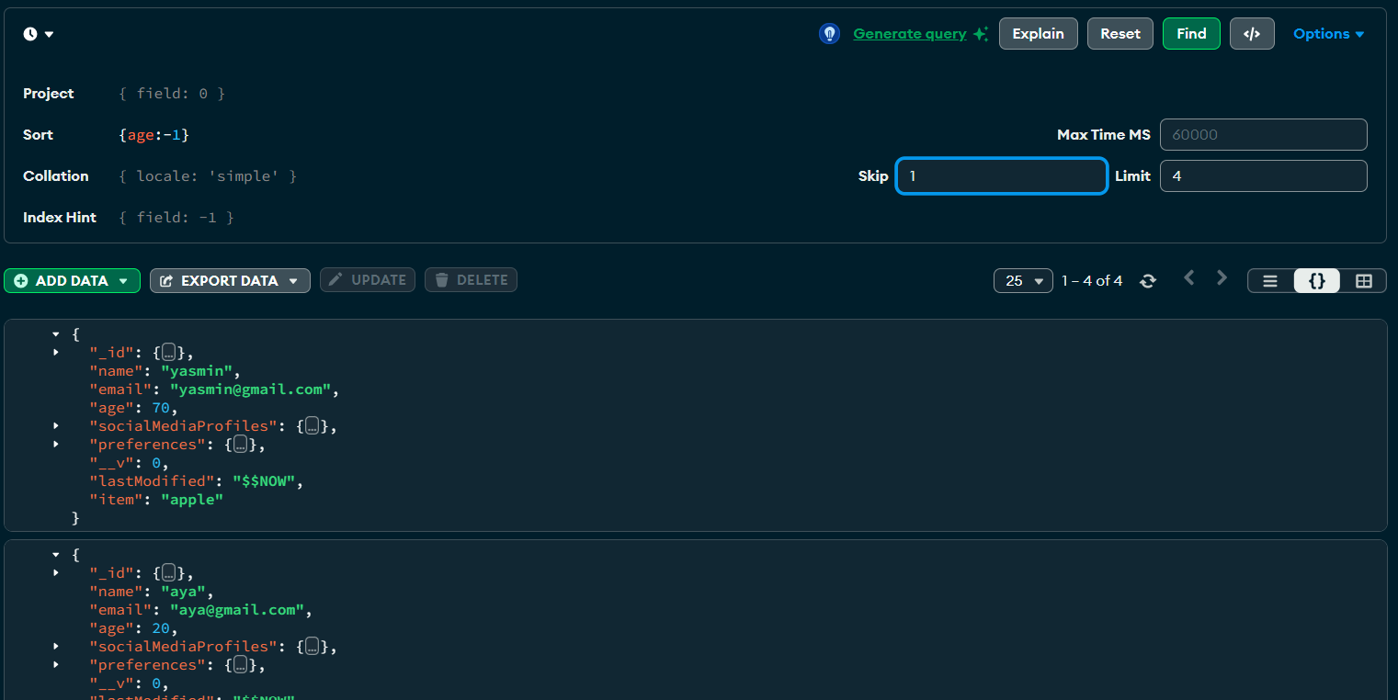
Sort, skip, Limit returned Documents

Slide 17
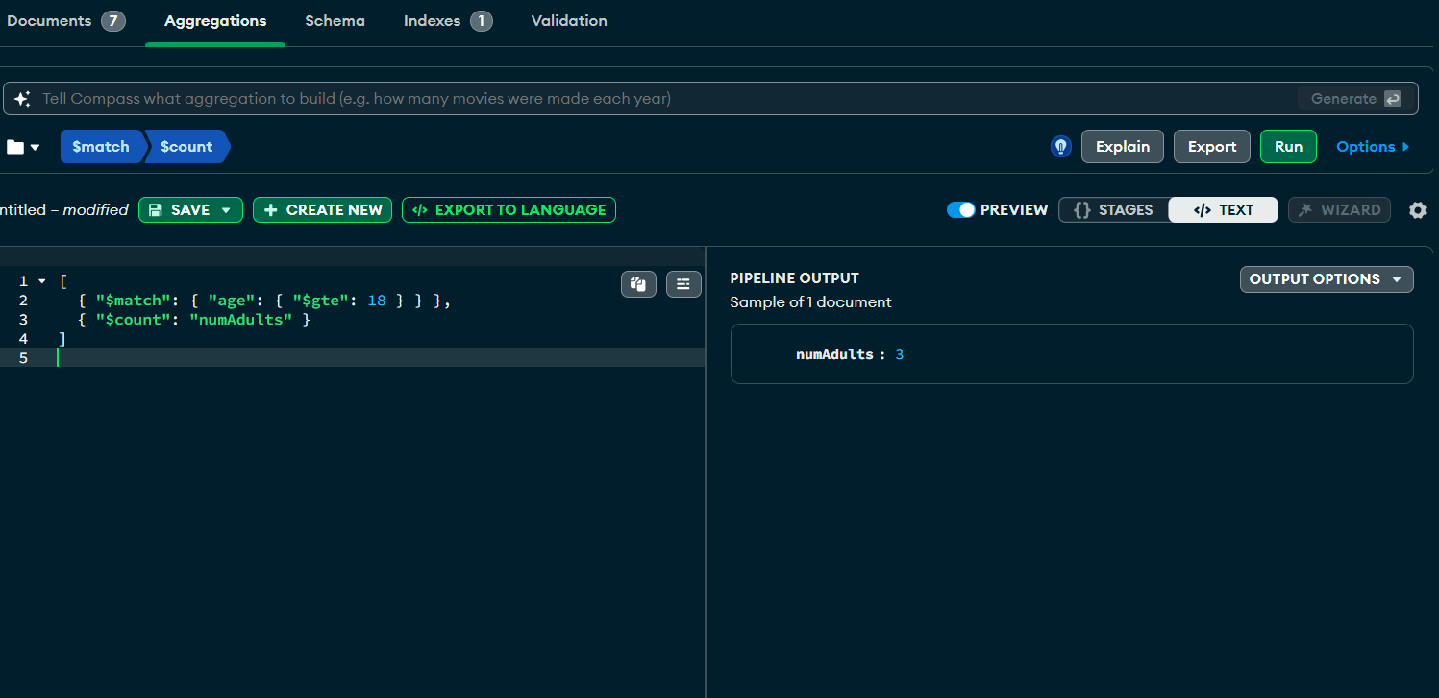
Aggregation operations – match > count

Slide 18
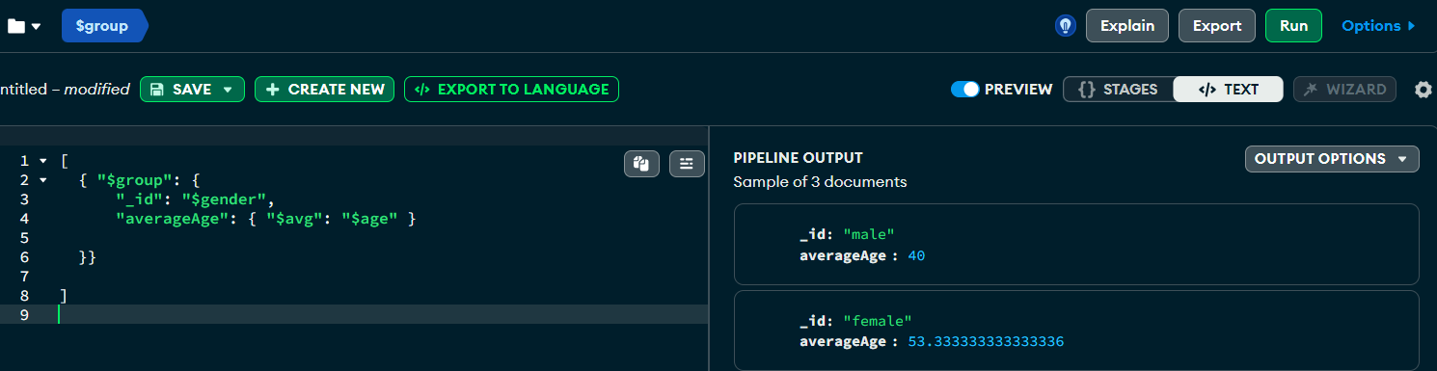
Aggregation operations – group > avg

Slide 19
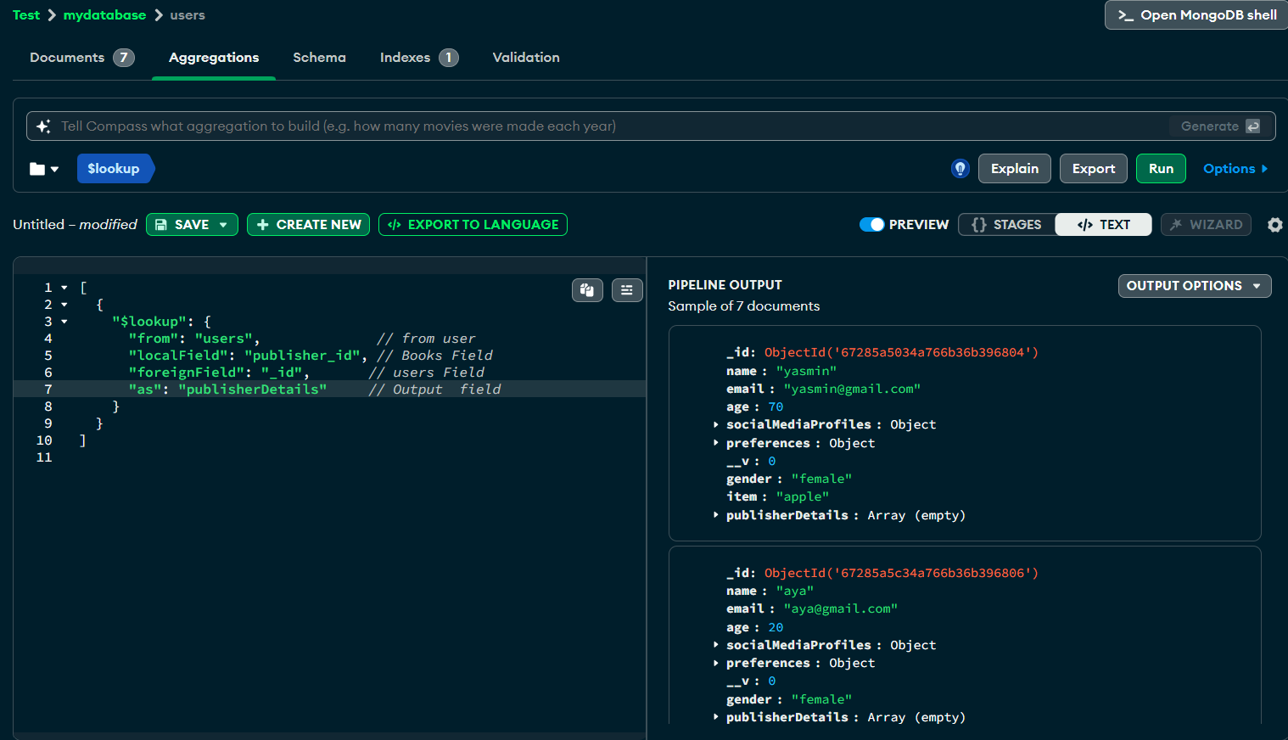
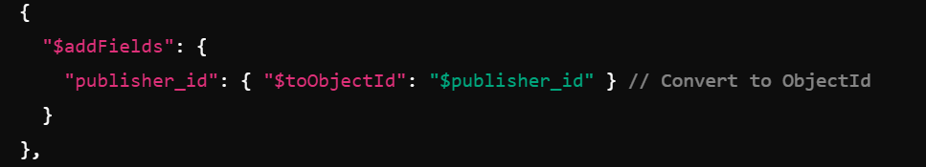
Aggregation operations – lookup

Slide 20
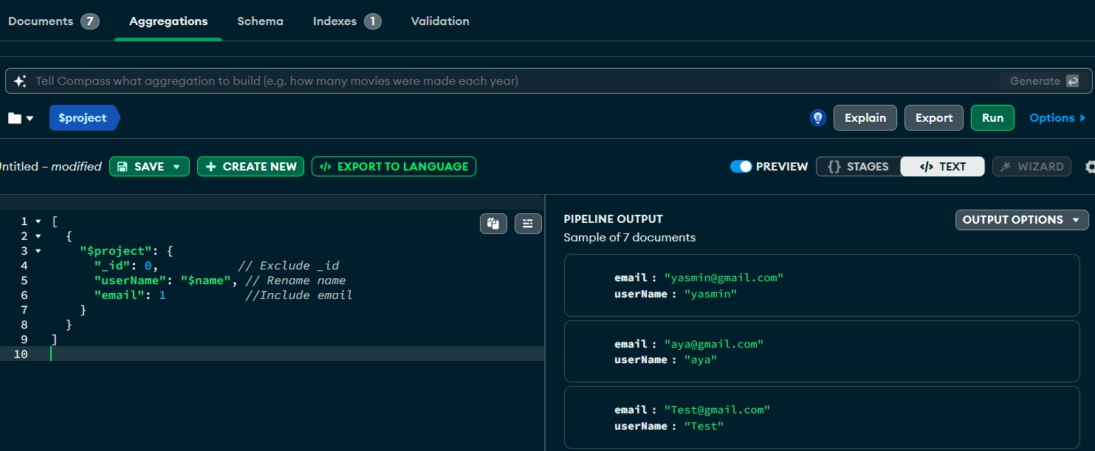
Aggregation operations – Project

Slide 21
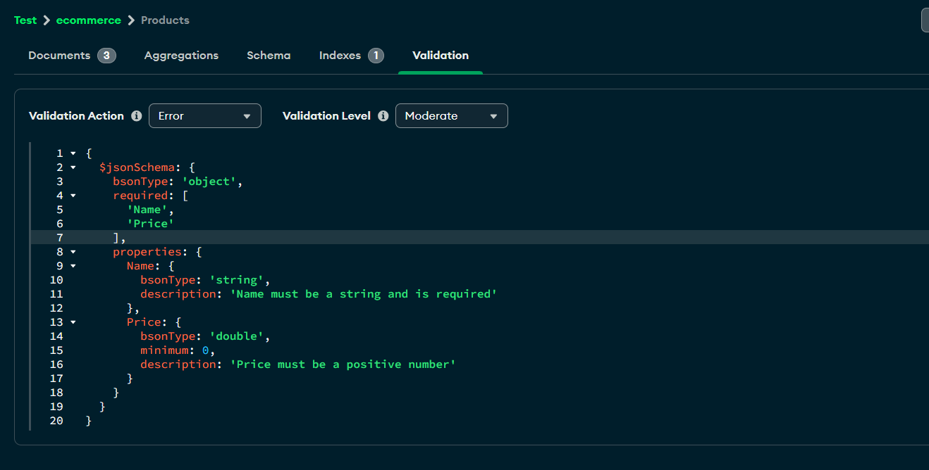
Validation

Slide 22
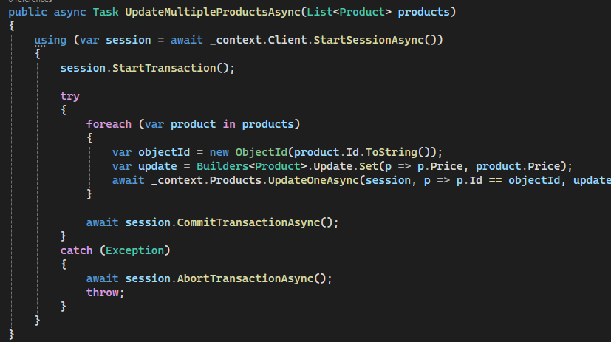
Transactions

Slide 23
Indexing
An index in MongoDB is a data structure that helps speed up queries. Without indexes, MongoDB would need to scan every document in the collection to fulfill a query, which could be very slow for large collections.
Types of Indexes
Single Field Index: Index on a single field.
Compound Index: Index on multiple fields.
Text Index: Index for text search.

Slide 24
Thank you
www.linkdevelopment.com

